Slide 1



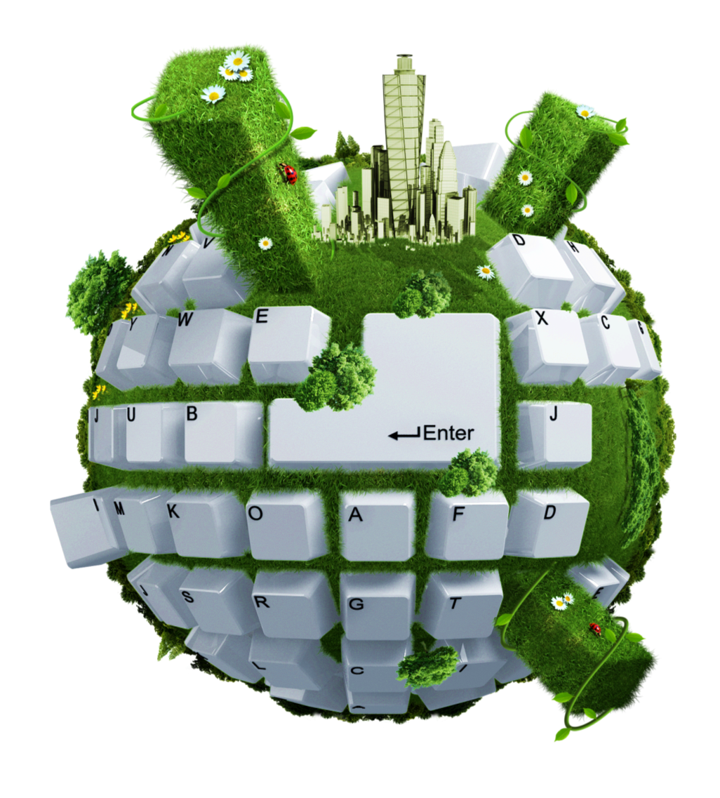




SDLC - Software Development Life Cycle
Let We Start A Real Time Web Application Development !!

Slide 2

Over View
What is SDLC ?
Why ?
Waterfall Model ?
Agile ?
Scrum ?
Sprints

Slide 3

SDLC
A framework that describes the activities performed at each stage of a software development project.
A systemic strategy for large-scale development projects.

Slide 4
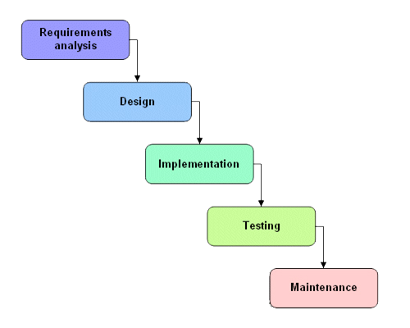
Waterfall Model
Requirements -
Defines needed information, function, behavior, performance and interfaces.
Design -
Data structures, software architecture, interface representations, algorithmic details.
Implementation -
source code, database, user documentation, testing.

Slide 5

Waterfall Strengths
Easy to understand, easy to use.
Provides structure to inexperienced staff
Milestones are well understood.
Sets requirements stability.
Good for management control (plan, staff, track).
Works well when quality is more important than cost or schedule.

Slide 6
Waterfall Deficiencies
All requirements must be known upfront
Integration is one big bang at the end
Little opportunity for customer to preview the system
(until it may be too late)
Can give a false impression of progress

Slide 7
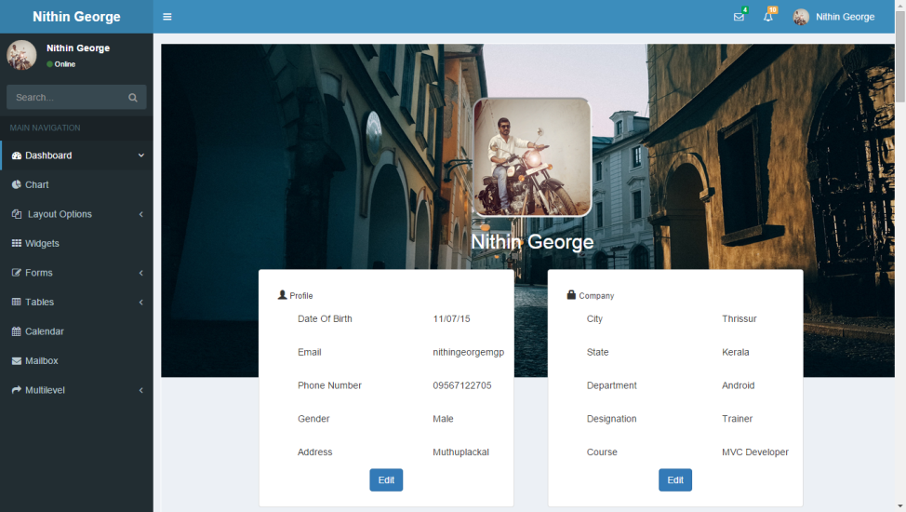
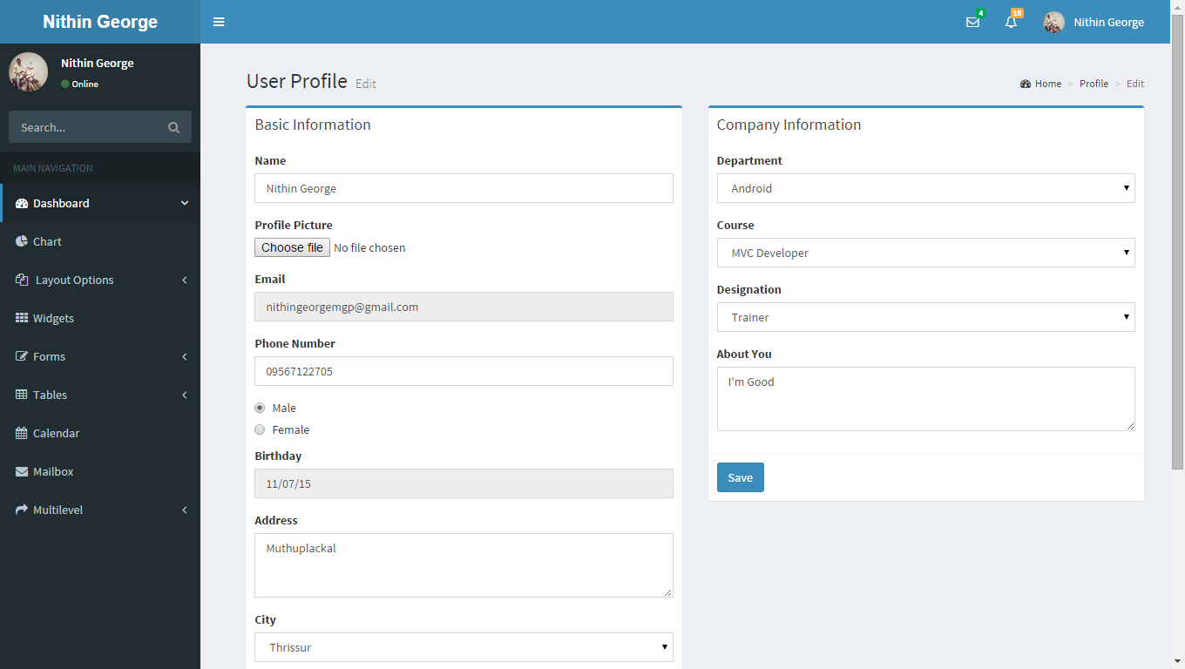
Our Project

Slide 8
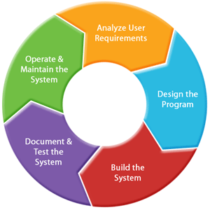
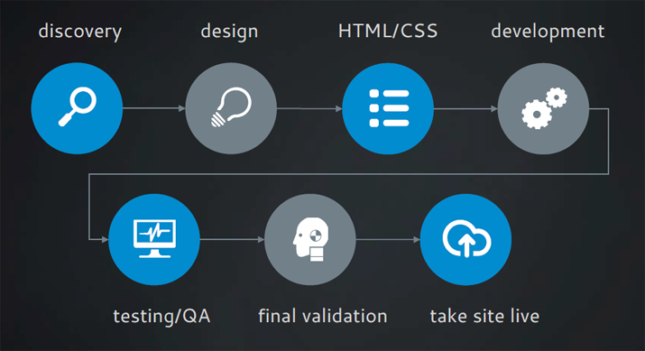
SDLC - Software Development Life Cycle

Slide 9

User Requirements Analysis
How and why will people use your product? What are the most important features for users? Which functions are most central? How should they be structured?
Features
Login
View All Users
Approve User Requests
Block Users
NoticeBoard & News
Add Videos & Notes
Admin

Slide 10


Login
Manage Profile
View Details & Edit
Change Password
View Notice Board & News
Alumni Connection
Chat
Messages
Send
View / Delete
Discussion Community
View Online User
Chat
Registered Users
Public Users
Learning Center
Manage Posts & Notes
Add Posts & Notes
View Details
Edit/Delete
Videos
View & Download
Home
Registration
Contact Us
About Us

Slide 11
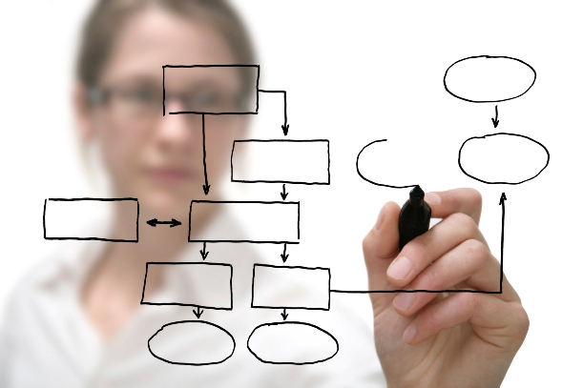
Design And Planning
During this phase your project is researched, planned out and built on paper. Time will be spent exploring potential vendors and technologies. They will provide you with wire frames and mock ups, design and relationship diagrams and other documentation. At the conclusion of Design, you should know exactly what you are building and how it will be built.
Create Use Case Diagram
Choose Design Pattern
Create Mockup Screens
Create A Scrum

Slide 12
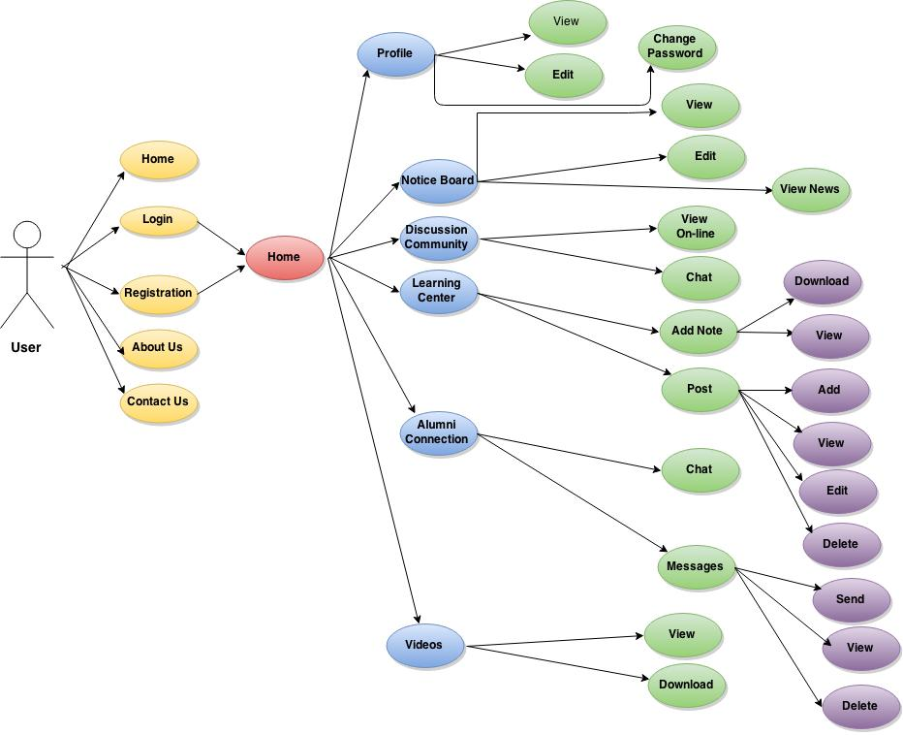
UseCase Digram

Slide 13
Agile
Agile SDLC model is a combination of iterative and incremental process models with focus on process adaptability and customer satisfaction by rapid delivery of working software product.
Agile Methods break the product into small incremental builds. These builds are provided in iterations.
At the end of the iteration a working product is displayed to the customer
Scrum is currently one of the most well known agile development.

Slide 14
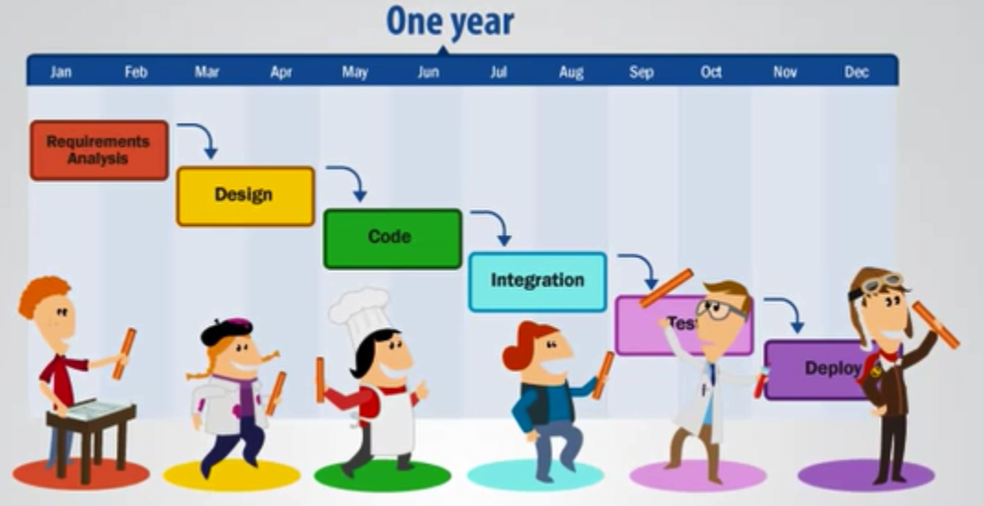
Scrum
Scrum is a simple framework for effective team collaboration on complex projects. Scrum provides a small set of rules that create just enough structure for teams to be able to focus their innovation on solving what might otherwise be an insurmountable challenge.
Development with out scrum

Slide 15

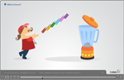
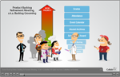
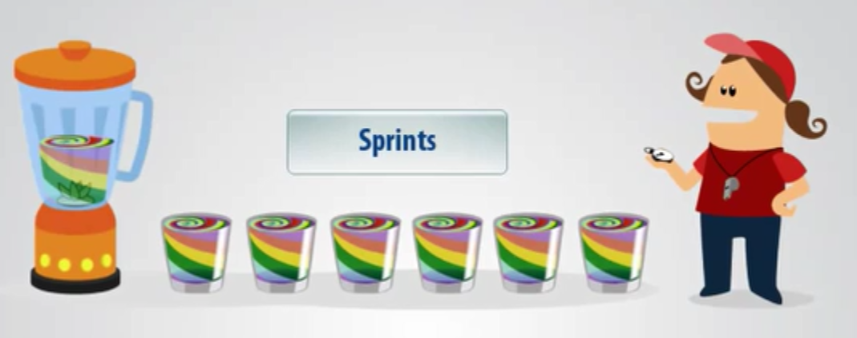
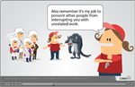
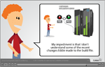
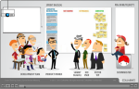
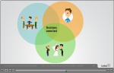
Introduction to Scrum
Backlog Refinement Meeting
Divided In to Sprints
Sprint Planning Meeting
Daily Scrum Meeting
Sprint Review Meeting
Sprint Retrospective Meeting

Slide 16

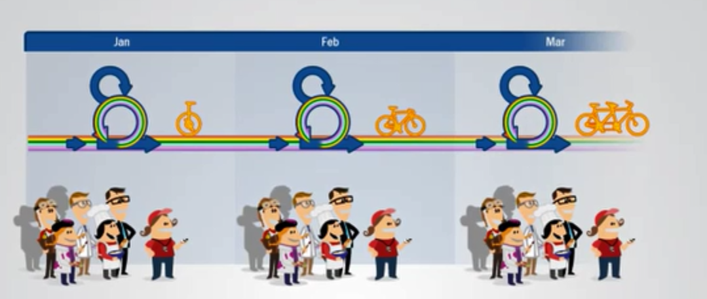
Work is confined to a regular, repeatable work cycle, known as a sprint or iteration. Scrum sprints used to be 30 days long, but today many teams prefer shorter sprints, such as one-week or two-week sprints.

Slide 17
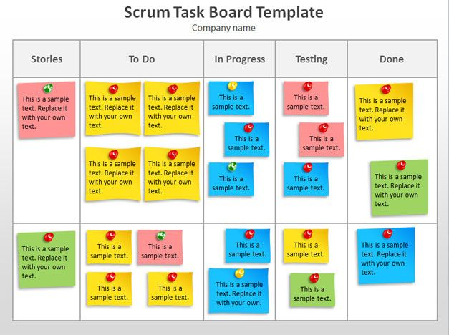
Schedule Scrum
List out project modules
Reordering modules with priority task
Divide into small sprints
Listing all backlog task in under each module
Fix the mile stones of project
Organize every day scrum meeting

Slide 18
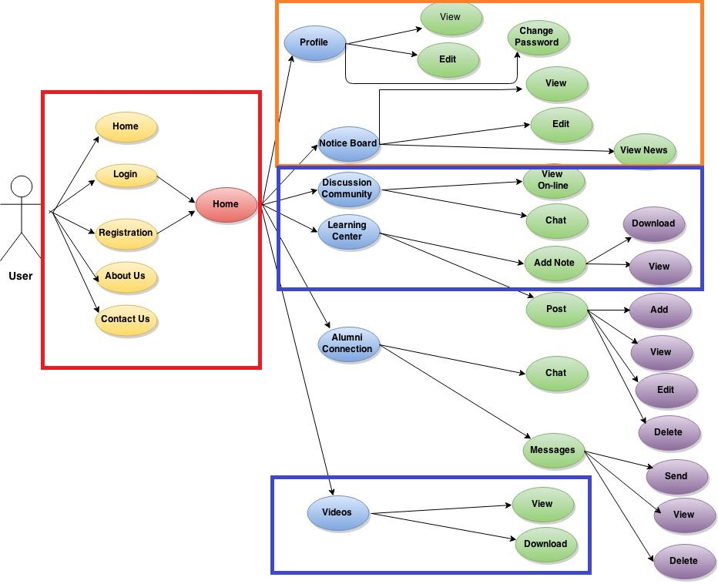
Convert our project to sprints

Slide 19

Other steps
Build the system
Document Testing
Operation & Maintenance

Slide 20

Summary
What is this SDLC
Waterfall Model
Agile
Scrum
Sprints

Slide 21

Question Time

Slide 22



